Slide 1
St. Therese Catholic Church
Book of Revelation
Chapters 10-11
January 7, 2025

Slide 2
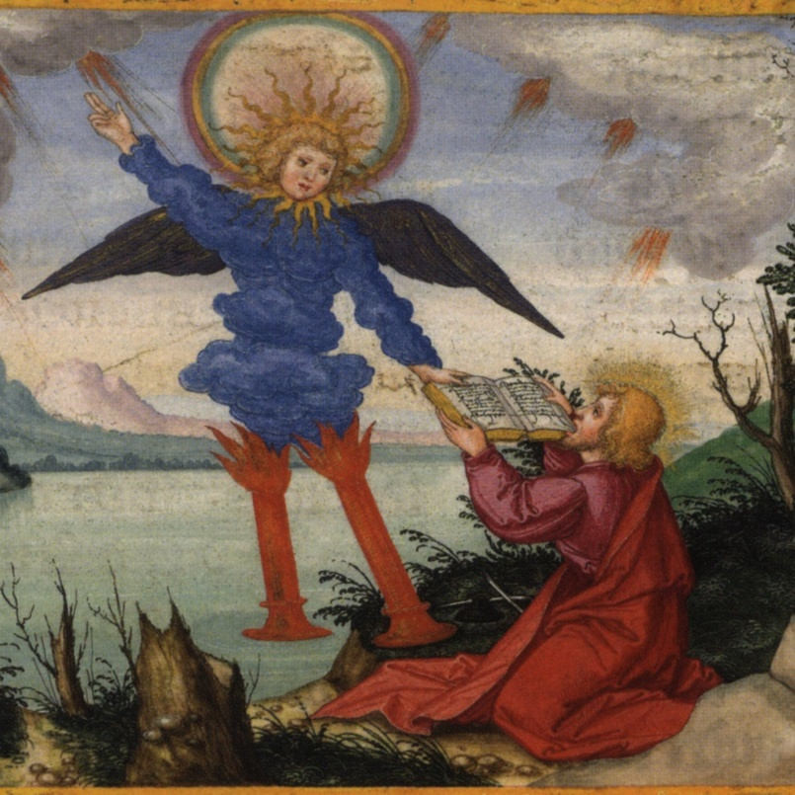
St. Therese Parish
An Interlude
Revelation 7 had two interludes that followed the opening of the sixth seal with the 144,000 and the white-robed multitude in heaven.
After the sixth trumpet, we have an interlude of two visions. The first vision is in chapter 10 with a mighty angel bringing the scroll whose seven seals have now been opened (5:7; 6:1-12; 8:1) and commissioning the prophet John to begin a new round of prophesying (179).

Slide 3
St. Therese Parish
A Mighty Angel
Mighty Angel: John saw a mighty angel in Rev. 5:2 who asked, “Who is worthy to open the scroll and break open its seals?”
Wrapped in a cloud: God often appeared in a cloud in the Old Testament (Ex. 13:20-22).
Halo around his head: “Rainbow” surrounded God’s throne in 4:3.
The angel has a message of capital importance (180).

Slide 4
St. Therese Parish
A Mighty Angel
The cloud symbolizes God’s presence; the rainbow is God’s mercy; his face like that of the Son of Man in 1:14 is divine fire (McIlraith, 93 – 94).
The angel may be Jesus Christ or an angel with divine authority of God and Christ (McIlraith, 94).
Small scroll that had been opened: The Lamb had removed the seven seals on the scroll in chapter 6 and 8:1.
Right foot on the sea and left foot on the land: Expresses the authority of what he is about to say to the whole earth as the sea represents the Gentile nations and land represents Israel.

Slide 5
St. Therese Parish
A Mighty Angel
Voice as a lion roars: Another sign of God’s presence as Amos 3:8 speaks of a lion roars – the Lord God has spoken.
The seven thunders: Indicates that God himself is speaking since Ps. 29 describes the “voice of the Lord” as thundering over the sea and the land seven times (181).
Do not write it down: May symbolize that God is not disclosing everything he has in mind to do (Dan. 12:4; 2 Cor. 12:4) (181).
Raised hand to heaven: The angel swears and oath, invoking the eternal Creator God who is supreme over everything (181).

Slide 6
St. Therese Parish
A Mighty Angel
Daniel 12:1-7 | Rev. 10:4-7
Speaks of a time of unsurpassed distress that is coming (12:1) | Time of distress with breaking of seals and blowing of trumpets
Daniel is told to keep the message secret and seal the book until the end of time | John is told to seal up what the seven thunders have spoken, but do not write it down
See two figures standing on either bank of the river | Angels standing on the sea and land raised his right hand to heaven
Man clothed in linen asks how long shall the appalling things be? | Martyrs under the altar ask how long before they are avenged (6:9-10)
Man clothed in linen lifts up hands to heaven and swears by Creator God | Angel raised his right hand to heaven and swears by Creator God

Slide 7
St. Therese Parish
Mysterious Plan of God
Seventh trumpet – Mysterious plan of God: The seventh trumpet will signal the fulfillment of all God’s promises to his people through the prophets – both those of the Old Testament and Christian prophets like John – promises of judgment against those who oppress God’s people and promises of salvation and comfort in God’s presence (181).
The ”mystery of God” is used throughout the New Testament and generally means God’s plan of salvation for all in Christ. ….The mystery or plan of God here boils down to the fact that God has planned an eternal kingdom which he will bring about (McIlraith, 94-95).

Slide 8
St. Therese Parish
Mysterious Plan of God
As we will see, the mystery of God has a positive element in that evil forces will be put down, justice will be served, God’s promises will be fulfilled, the reign of God will be established, and all creation will be renewed.
However, we will also see a negative side for those who refuse God’s love and cling to idolatry and evil works, i.e., they will be judged by these very works (20:11-15) and find their proper place while God’s enemies will also end up in the lake of fire (McIlraith, 95).
In short, we have a deferred expectation that God’s plan will be accomplished even before the New Jerusalem comes down out of heaven at the end of the book (183).

Slide 9
St. Therese Parish
A New Commission
Ezekiel 2:9 – 3:3 | Revelation 10:8 – 10
Ezekiel is shown a scroll with writing front and back | John is told to take the scroll from the angel
Written on it is lamentation and woe | The scroll has writing front and back (Rev. 5:1) filled with woe
He is told to eat the scroll, then go, speak to the house of Israel | John is told to take the scroll and the angel tells him to eat it
Ezekiel eats the scroll and it was as sweet as honey in his mouth | The scroll is sweet as honey in his mouth and sour in his stomach

Slide 10
St. Therese Parish
A New Commission
In both cases, the prophet receives and assimilates God’s word until it becomes part of him. He then expresses it the best he can in writing or in speech aided by the Holy Spirit (184).
For both Ezekiel and John, God’s word is sweet as honey. He will share Ezekiel’s experience, however, that will leave him “in bitterness in the heat of my spirit” (Ezek. 3:14) (184).
Key: John receives a word of judgment or he anticipates the hardships that await God’s people in what lies ahead (184).

Slide 11
St. Therese Parish
A New Commission
In this new commission, John is being commanded to prophesy the contents of the scroll he has eaten.
This new phase of his prophetic ministry will reveal the contents of the scroll that the Lamb received from God in chapter 5 (184).
While Ezekiel’s message was to warn the people of Israel, John’s message is to or about many peoples, nations, tongues, and kings. It has worldwide significance. The mention of kings indicates that the message touches on how political power is exercised on earth (184).

Slide 12
St. Therese Parish
Chapter 11
In Revelation 7, John received a two-part revelation about God’s seal of protection on his servants and a vision of their blessed state on the other side of the great distress (185).
Here John receives a two-part revelation of the role of the Church in God’s plan by means of being commanded to perform a symbolic action (11:1-2) and being told a prophetic allegory about the Church’s future (11:3-13).
At the end of the allegory, the seventh trumpet sounds (11:15), marking the days when “the mysterious plan should be fulfilled” (10:7), and voices in heaven erupt in celebration that the kingdom of God has finally arrived (185).

Slide 13
St. Therese Parish
Measuring the Temple
Measure the temple: In one of Ezekiel’s visions, he is told to measure the dimensions of the new temple where God will come to dwell with his people forever (Ezek. 40:3-43:5). It is likely that God’s temple in heaven is intended (187).
The interpretation that seems most likely is that here the temple of God refers to the Church, God’s dwelling on earth, a familiar concept to the early Christians (187).
Measuring the temple suggests that God will preserve a faithful remnant who remain true to Christ. God will spiritually protect the Church, which is in communion with God’s temple in heaven.

Slide 14
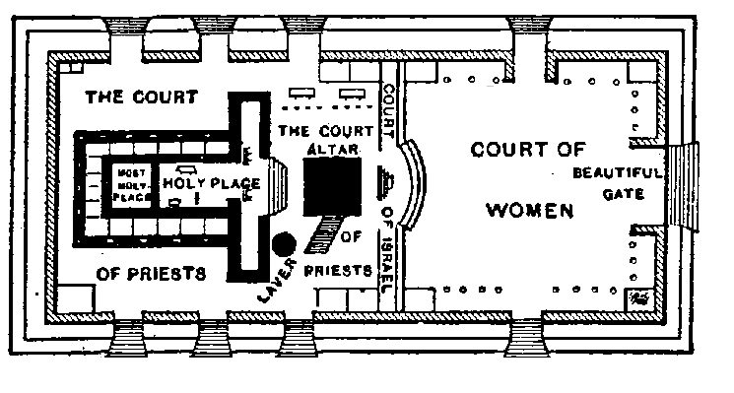
St. Therese Parish
The Jerusalem Temple
https://www.templemount.org/theories.html

Slide 15
St. Therese Parish
Measuring the Temple
Worshipping in it: Given that only priests had access to the sanctuary and altar, those worshipping function as priests (188).
John is told to measure the temple and count the worshippers suggesting that the temple is under construction. The age of the Church is the period during which God’s temple is being built (1 Cor. 3:9-17) (188).
New members are being added and those in the Church are being strengthened in it until the descent of the New Jerusalem. God keeps watch over his people and will protect them (188).

Slide 16
St. Therese Parish
Measuring the Temple
Exclude the outer court: The outer court has been handed over (a divine passive) to the Gentiles, who will trample the holy city for a period of time (188).
The expression “Gentiles” here refers not to ethnicity but to those who do not belong to God’s covenant people (188).
The trampling alludes to Daniel 8:10, 13, which speak of an antichrist figure who tramples ”the host” of God’s people (188).
The “holy city” refers to Jerusalem, but here as in 20:9 and 21:2, Jerusalem symbolizes the people of God rather than the earthly location (188).

Slide 17
St. Therese Parish
Measuring the Temple
Revelation Symbol | Meaning
Measuring the temple | God’s spiritual protection
Count those worshipping in it | Those who acknowledge and worship God as first love
Outer court of the temple | The world controlled by those who oppose God (the Gentiles)
Will trample | Those who persecute and kill God’s people (the “holy city”)
Forty-two months (or 1,260 days – 42 x 30 = 1,260 or 3.5 years) | Equal to three and a half years – a limited time of tribulation

Slide 18
St. Therese Parish
Limited Tribulation
Revelation uses various ways to express that God’s covenant people or the Church will experience persecution (will be trampled) for a limited time.
The Book of Daniel uses the phrase “three and a half years” (half of seven) to represent the eschatological (end of time) persecution and tribulation (Dan. 7:25; 9:27; 12:7, 11-12).
While originally it may have been the literal period of persecution by the Syrian ruler Antiochus Epiphanes (164– 167 BC) who desecrated the Jerusalem temple, Jewish and Christian tradition came to understand this period as a type (or foreshadowing) of the great trial at the end of history (189).

Slide 19
St. Therese Parish
Limited Tribulation
The number three and a half is symbolically significant because it is half of seven, a number that indicates totality. Thus, three and a half years refers to a temporary period of trial that God allows (see Mark 13:20) (189).
The Fathers of the Church as well as modern scholars have differed over whether to understand three and a half years as referring to the entire age of the Church or to the period of more intense persecution when the antichrist appears at the end of history (189).
Likely, it refers both to the entire history of the Church and in a particular way to the Church’s ultimate trial (189).

Slide 20
St. Therese Parish
Two Witnesses
I will commission: Christ commissions his two witnesses to prophesy for twelve hundred and sixty days, wearing sackcloth.
Twelve hundred and sixty days is equivalent to forty months or three and a half years (a temporary period of tribulation).
Two witnesses: A symbolic dramatization – an allegory or parable – of the Church’s mission (190).
The two witnesses symbolizing the testimony of the Church as a whole throughout history may also include a more literal fulfillment through a pair of witnesses who testify with particular power during the Church’s final trial (190).

Slide 21
St. Therese Parish
Two Witnesses
Note: Beside Moses and Elijah, the Church has had pairs of powerful witnesses throughout its history: Peter and Paul, Francis and Dominic, Teresa Avila and John of the Cross, etc.
Sackcloth: A coarse fabric made from the hair of goats or camels, worn to signify mourning or repentance (Jon. 3:8).
The fact that the witnesses wear sackcloth means either that they themselves have repented, that they are grieved by the sin and idolatry they see, that they preach repentance, or all of the above (191).

Slide 22
St. Therese Parish
Two Witnesses
Two olive trees and two lampstands: An illusion to a strange vision recorded in Zechariah 4 (191).
Zerubbabel and Joshua were so anointed for their tasks that they were not just smeared with olive oil but presented as olive trees themselves (191).
Zechariah 4 | Meaning
One lampstand with seven lamps upon it (menorah lighting temple) | Symbolizes the second temple, under construction despite fierce opposition (520 – 515 BC)
Two olive trees that give oil for the menorah | Zerubbabel: the governor and Davidic heir Joshua: the high priest, who lead the rebuilding the temple

Slide 23
St. Therese Parish
Two Witnesses
Just as Zerubbabel and Joshua were the Lord’s anointed instruments in building the second temple (520 – 515 BC), the two witnesses whom Christ authorized prepare the way of the eschatological temple, the new Jerusalem (191).
In chapters 1-2, the seven golden lampstands represent the Church throughout Asia and the world. A lampstand is a fitting symbol of the Church: it is the means by which the light of Christ and of his sevenfold Spirit shines in the world (191).
Key: The two lampstands and two witnesses represent the Church’s witness to the world (192).

Slide 24
St. Therese Parish
Two Witnesses
The two witnesses could refer to Jesus Christ (first witness) and the Holy Spirit (second witness).
  John 15:26: When the Advocate comes whom I will send you from the Father, the Spirit of truth that proceeds from the Father, he will testify to me.
Throughout Scripture the legal standard for judicial testimony is two witnesses. In the Gospel of John (16:8-11), the world is on trial. The two witnesses give adequate testimony of Jesus Christ and those who have heard are responsible for their choices (192). ….The gospel is both an offer a grace and a solemn command to repent (14:7) (192).

Slide 25
St. Therese Parish
Two Witnesses
In the Old Testament, Moses gave testimony of God against Pharaoh and the gods of Egypt (Ex. 7:14-21; 12:12). Elijah gave testimony against King Ahab and the prophets of Baal (1 Kings 18) (192). Like Moses and Elijah, the witnesses enjoy protection and the authority of God to overcome those who oppose them.
Moses | Elijah
Turned water into blood | Fire sent from heaven to devour King Ahab’s soldiers when they came to arrest Elijah (2 Kgs 1:10-12).
Afflicted the earth with any plague as often as they wish | Closed up the sky so that no rain could fall during time of prophesying

Slide 26
St. Therese Parish
Defeat and Vindication
Finished their testimony: God allows his two witnesses to be silenced just as Jesus was at the end of his life.
The beast: The first mention of the beast in Revelation (194).
Daniel 7 (Fourth Beast) | Revelation 11 (The Beast)
Comes up from the sea (Dan. 7:3) | Comes up from the abyss (Rev. 11:7)
Beast wages war against the holy ones and was victorious (Dan. 7:21) | Beast wages war against them and conquer them and kill them (Rev. 11:7)
God’s people were handed over to the beast for a year, two years, and a half-year (Dan. 7:25) | Outer court of temple handed over to Gentiles who will trample it for forty-two months (Rev. 11:2).

Slide 27
St. Therese Parish
Death and Vindication
Corpses lie in the main street: The city may be Babylon, which refers to Rome.
Sodom: A city known for its wickedness, including sexual immorality.
Egypt: A nation famous for the judgments God executed against it (194).
Note: In both cities, there was an exodus - God led and protected his people – Lot from Sodom and Israel from Egypt.
Where Lord was crucified: Jerusalem (there will be an exodus)

Slide 28
St. Therese Parish
Death and Vindication
The symbolic geography of 11:1-2 (measuring the temple) is extended here: the temple and the holy city Jerusalem refer to God’s people at worship (194).
The outer court trampled by the Gentiles symbolizes the world system that is opposed to God and his people and was embodied in Sodom, Egypt, Babylon, Rome, and the earthly Jerusalem that put Jesus to death (194-195).
Gaze on their corpses: The bodies of the witnesses are desecrated by being left unburied in the main street of the great city where they are the butt of the rejoicing of the earth dwellers of the entire world (McIlraith, 101).

Slide 29
St. Therese Parish
Death and Vindication
Three and a half days: Half of the perfect seven. Indicates that the beast’s victory is only temporary (McIlraith, 101-102).
Not allow to be buried: In the ancient world, it was considered the ultimate insult and cruelty refusing to allow their corpses to buried (195).
Exchange gifts: The reason for their celebration of the death and hatred for the two witnesses are because their prophesying had tormented the world (McIlraith, 102).
Prophecy and righteous conduct elicit hostility and can feel like torment to those who do not want to repent (195).

Slide 30
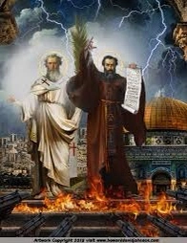
St. Therese Parish
Death and Vindication
Breath of life from God: After the three and a half days comes the triumph of the witnesses, their resurrection through the spirit and public ascension into heaven (McIlraith, 102).
John’s vision echoes Ezekiel’s vision of the eschatological (end times) restoration of Israel, where the breath of God “entered into them, and they live, and stood up on their feet, a very great congregation (195).

Slide 31
St. Therese Parish
Death and Vindication
Great fear: Echoes the reaction of the Egyptians (Ps. 105:38) and the inhabitants of Canaan (Ex. 15:16) at the manifestation of God’s power (195).
Come up here: The same words addressed to John in 4:1.
To heaven in a cloud: Reminiscent of Elijah (2 Kgs 2:11-12), Moses (according to Jewish tradition), Jesus’ Ascension into heaven, and the Blessed Virgin Mary (195).
Enemies looked on: By now the unbelieving world at least knows that there is a God who raises his witnesses from the dead and takes them to heaven (McIlraith, 102).

Slide 32
St. Therese Parish
Death and Vindication
Summary of Two Witnesses
The Church’s witness to the world will be powerfully anointed. | At a future time of his choosing, God will allow the beast and his followers to seemingly defeat the Church, silencing her witnesses and producing many martyrs.
It will provoke fierce opposition from those who find their evildoing exposed, who hate and reject the Christian message. | This seems to be another reference to the great trial and the persecution of the Church before Christ’s return (CCC 675).
The Church will remain protected by God until the time when he considers her testimony complete. | The resurrection of the dead and the glorification of his people will be God’s vindication of his own. On that day, it will be seen by all who once persecuted the Church (196).

Slide 33
St. Therese Parish
Response of the People
Great earthquake: In Scripture, earthquake signifies a theophany, a manifestation of God’s presence, and often, as here, God’s coming in judgment (196).
Tenth of the city: God’s judgment is partial. A substantial number of people die (7,000), but it is only a fraction of the total population (196).
The city: Symbolizes all the inhabitants of the earth who have opposed the testimony of the Church, the two witnesses (196).
Rest were terrified: Whereas the previous judgments of failed to evoke a response, a more positive response is given here.

Slide 34
St. Therese Parish
Missionary Mandate
Revelation 11 is the missionary mandate of the Apocalypse. Here, the missionary mandate is contained in the command to prophesy.
This book also shows the authority and power given to missionary witnesses, signs of God’s protection of their witnessing.
Before the final trumpet sounds and the third woe launches the ill-fated attack of Satan himself on Christ and his Wife, the Church, we discover that Christ’s espoused Wife is a missionary Wife and has a vital role to play with her Bridegroom in the salvation of the world (McIlraith, 103).

Slide 35
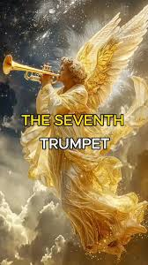
St. Therese Parish
Seventh Trumpet
Just as the seventh seal contained the seven trumpets, so the seventh trumpet contains the rest of the book up to the epilogue (Rev. 22:6-21) (McIlraith, 109).
The seventh seal was followed by silence. The seventh trumpet is followed by a victory cry from heaven. This trumpeter leads ultimately to the fall of Babylon and the vision of the New Jerusalem, the Bride (McIlraith, 109).

Slide 36
St. Therese Parish
Seventh Trumpet
The third and final woe is here also. After the first two woes, which accompanied the fifth and sixth trumpets for those who did not receive the seal of God, the audience may wonder what the third woe and seventh trumpet could possibly entail since it is coming soon (200).
The first two woes included demonic elements. This crescendos to the third woe: the appearance of Satan himself who attacks Christ and the Church (McIlraith, 110).
As we see however, the woe does not follow the trumpet blast immediately. The seventh trumpet blast is more about victory than woe (McIlraith, 110).

Slide 37
St. Therese Parish
Hymn of Thanksgiving
Now, we are only halfway through the Apocalypse. From Revelation 12 to 20 we are going to hear of the war that Satan makes on the Church and how he persecutes the Church through the kingdom he has built with the help of the two beasts (McIlraith, 110).
We will see the outpouring of all seven bowls of God’s wrath to overcome this, and we will see how the result of this is the judgment and fall of the harlot city Babylon (McIlraith, 110).
God’s enemies will also be death with in Revelation 20. After that we will see the eternal Kingdom established through the Marriage of the Lamb (McIlraith, 110).

Slide 38
St. Therese Parish
Hymn of Thanksgiving
But this is all in the future. The twenty-four elders prostrate themselves and worship God singing a hymn of thanksgiving about God’s power, judgment of the dead, rewards for his prophets and holy ones, and destruction of all who oppose his Kingdom as if it has already happened!
Because God reigns through Christ forever, the elders know what will be as what already is (McIlraith, 111).
In short, the hymn is a very clever summary of the rest of the book. We must remember too that in each individual who opts for Jesus, the kingdom of this world becomes the Kingdom of God (McIllraith, 111). They, too, share in God’s victory.

Slide 39

St. Therese Parish
Next Time
Tuesday, January 21st
Revelation 11:19
The Ark of the Covenant | 11:19
Revelation 12
The Woman and the Dragon | 12:1-18

